Slide 1

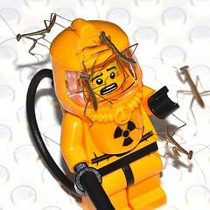
Lighting your LEGO City
http://www.ilugny.org
How to add LED lights to your LEGO town or city layout, without breaking the bank.
Will Smart – 5/10/2013 – Brickfair NE

Slide 2
What is all this?
I'll talk about how I came up with the system I'm using.
I'll describe how to do it, step by step.
I'll take questions, show the system installed in a creator lighthouse, and make wire up an LED or two right in front of everybody!

Slide 3
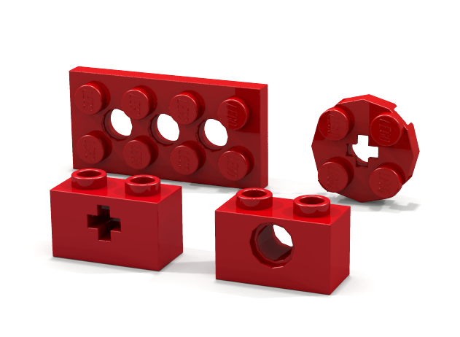
Why bother?
Commercially available LEGO and 3rd party lights don't meet my needs.
Fixed length leads, and connectors that cannot pass through a technic hole, or LED's that will not fit inside a 1x1 round brick. All commercially available kits have at least one of these problems.
Pre-made kits are 2-3 times the price of DIY lighting,
making it prohibitively expensive for anything other
than a small MOC.
I want to spend my money on bricks, not lights!

Slide 4
Goals
This all started out as a way to light up a relatively small Christmas diorama.
Goals
  Develop a standard that LUG mates can build into their own MOC's.
  Including investment in tools, it should cost no more than the popular commercial options for 100 lights.
  Must be able to be battery powered, or run from an A/C source.
  Should work well with modern microcontrollers (Arduino)

Slide 5
Picking The LED's
It was important that the LED's had the following properties:
  Size: 3mm (T1) - So it can fit through a technic hole.
  Color: White - So I can modify the color with transparent LEGO elements.
  Lens: Clear (not diffuse) - You can diffuse the light from an LED by sanding the lens.
  Mounting: Through Hole (not surface mount) - These have the leads attached.
  Forward Voltage: Must operate with a 2.4v power source - so it can be powered by two rechargeable batteries.
I settled on VCC VAOL-3GWY4 purchased from Allied Electronics
They have all of these characteristics, for about 30 cents each - less if you buy 100 or more.

Slide 6
Picking the resistors - how do you know how many "ohms" to use?
Ohm's law (V=IR)
  Now that I've picked the LED's, I can figure out how much voltage (V) and current (I) are required.
  From that, you can calculate the resistance: R=V/I
Or, you can do it the easy way: http://led.linear1.org/led.wiz
You need to know:
  Your LED's Forward Voltage (from the spec sheet)
  You LED’s Forward Current (from the spec sheet)
  The Power Supply you plan on using (more on that later)

Slide 7
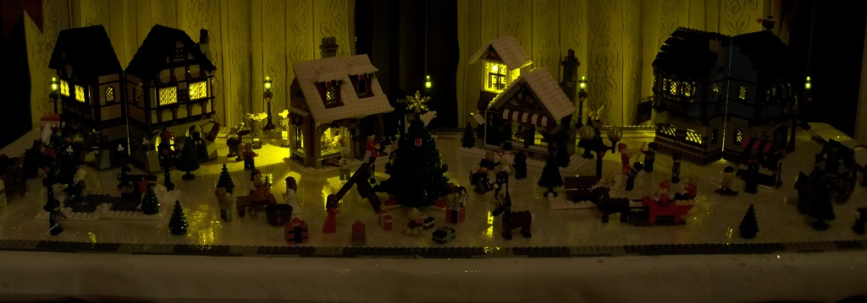
Version 1 (2010)
My only goal was to add some soft lights to a small Christmas display.
I wanted it to run for a good amount of time off of rechargeable batteries.
It turned out OK, but the lights were not very bright, and the system wasn't terribly flexible.

Slide 8
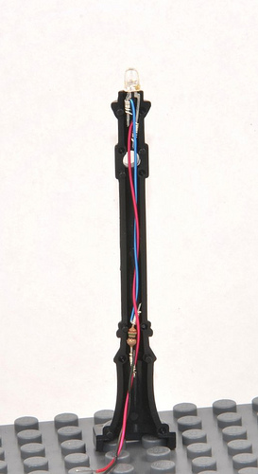
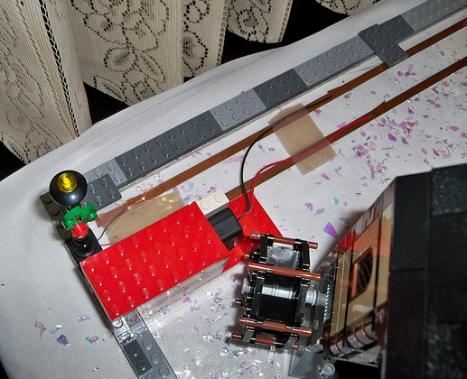
Version 1 (2010)
Power Source: 2 rechargeable AAA's (2.4v)
Transmission: Copper Tape
Resistors in the (Brickforge) lamp post.

Slide 9
Version 1 (2010)
The original plan was to stick the copper tape on the underside of a baseplate.
I thought the copper tape would be ideal, but...
Lights turned out to be very finicky, and the electrical connections were not great.
Maybe I'll revisit the copper tape in the future, but for now, it simply wasn't going to work.
Back to the drawing board.

Slide 10
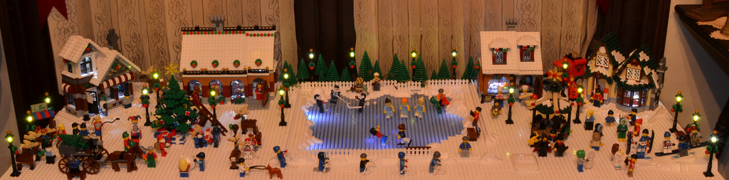
Version 2 (2011)
With a larger LEGO collection, and the willingness to modify some 6x6 white plates, the next year's LEGO display was much more impressive.
Raised plates allowed me to hide all the wiring, which in turn allowed for nicer effects, and more lights.

Slide 11
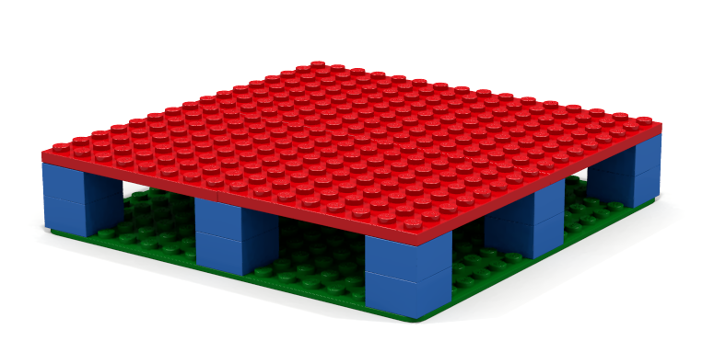
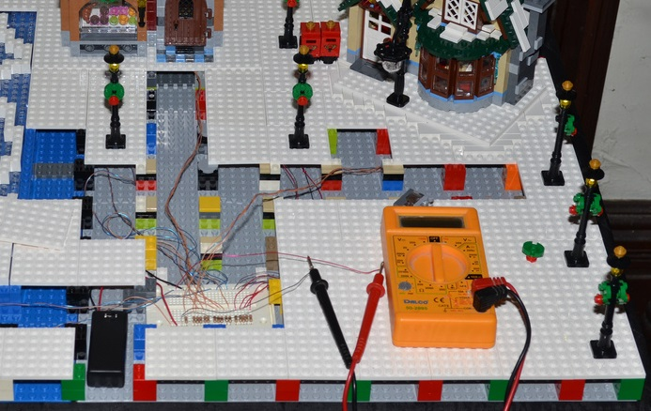
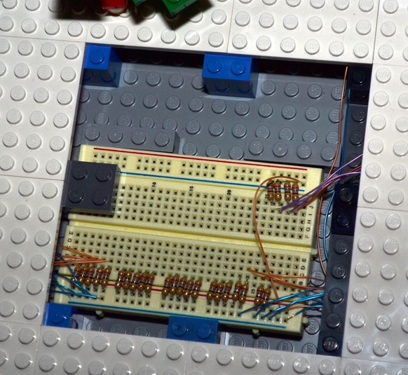
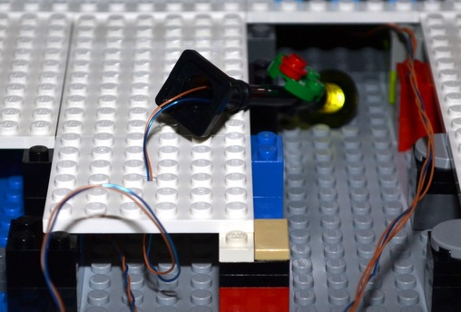
Version 2 (2011)
Raised Baseplates
Modified plates (holes drilled in 6x6 white plates)
Breadboards to make it easier to connect and disconnect
Resistors mounted on the breadboard, not in the lamp post.

Slide 12
Version 2 (2011)
Using the 30 gauge wire in the breadboards were more reliable than copper tape, but not as forgiving as I wanted.
I was still fairly happy with the system, but as it turned out, I would learn a lot before I worked on lighting again...
In 2012....
I discovered MILS
I started reading up on LEGO Power Functions
I finally found an affordable source of connectors & crimp tool.

Slide 13
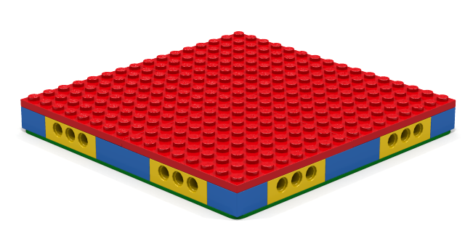
Enter MILS
Modular Integrated Landscape System
Standard published in Hispabrick #13, January 2012
http://www.abellon.net/MILS/index.html
Not only would it work to hide wires, but it will help with collaborative displays.
I decided that my next lighting system would be based on MILS. I would have to make some modifications for components that could not fit in the reduced space, but the modularity would be worth the trouble.

Slide 14
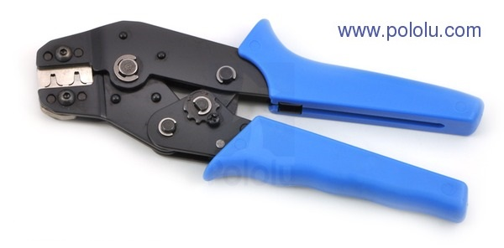
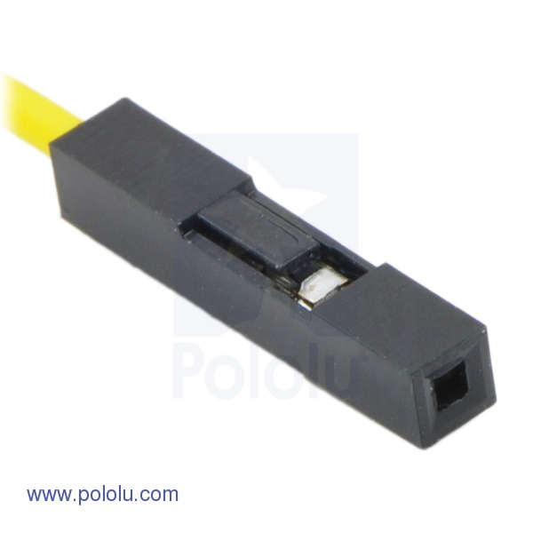
Using the right tool for the job
In January, I finally discovered an affordable crimping tool and connectors that would fit through most technic holes and axle holes.
Even better - it was based on the standard 0.1" pin spacing that the breadboards use.
This would finally solve the issues with needing a single continous wire from the power source (breadboard) to the LED - no matter how far away it was.
It would also make the connection to the breadboard more reliable.
Pololu has some great learning resources too: http://www.pololu.com/catalog/product/1929/resources

Slide 15
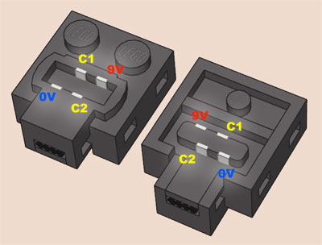
From Trains to Power Functions
I bought a Red Cargo train during November's Brick Friday event - and discovered how excellent LEGO power functions really were.
The most important fact: Power Functions used PWM (Pulse Width Modulation) to control the brightness of the PF LED lights, and the motor speed.
What is PWM? Like flipping a switch on and off really quickly, speed or brightness is controlled by what percentage of the time the switch is "on" vs. "off".
Excellent Power Functions Resource: http://www.philohome.com/pf/pf.htm

Slide 16
Putting it all together: Version 3
Still a work in progress
Still using wire wrapping and breadboards, but added connectors to each light, and using MILS to hide the wires.
Connectors can pass through a standard 3mm technic hole, or even a technic "+" style axle hole!
Resistors have moved back in line with the lights
Using 0.1" crimp connectors to make power distribution easier
(Optionally) Using a 3.3v voltage regulator to accept a variety of power sources, including PF battery boxes.
Side effect of the bump up to 3.3v is brighter lights.

Slide 17
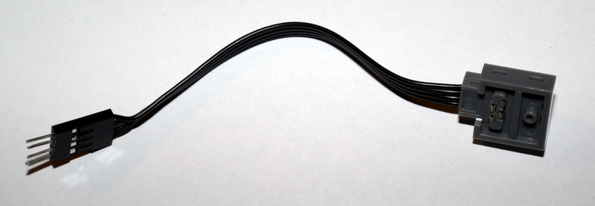
Version 3 (2013)
The biggest change to the system electrically, is the switch to a 3.3v step-down regulator, and using a PF battery box.
This offers some great advantages, including the ability to hook into 9v train regulators.
Both halves of an 8886 (8") or 8871 (20") are useful, but I am currently only using the PF half (PF connector on both the top and bottom).

Slide 18
You can build it!
This part of the presentation will be about how you can make these lights.
I'm not going to go into great detail about how to solder or crimp, because there are already many, excellent youtube videos on the subject.
Surprisingly, there are few videos on how to wire-wrap, some of them give fairly bad advice, and most of them are about "wire wrapping jewelry"
Glow-in-the-dark LEGO Octopus used throughout for scale - and occasionally as a set of helping hands.

Slide 19
Tools
You'll need:
Crimper: $35 from Pololu.com
Wire-wrapping tool: $7 from Radio Shack
  I've been using a WSU-30: $31 from Amazon
Multimeter: under $10 from various sources (you don't need anything fancy)
Wire strippers: $10 from Radio Shack
A Sharp knife, scissors or multi-tool.
A soldering iron (optional): Radio Shack sells a cheap "basic" set for $11.

Slide 20
Consumables
27 Ohm, ¼ watt resistors: about $3 for 100
LED's - I used VCC VAOL-3GWY4 from Allied Electronics: about $27 for 100
Some wire-wrapping wire: $6 per 50' from Radio Shack
  I recommend at least to different colored 50' spools.
1x1 Pin Crimp Connector Housings: $.60 per 25-pack at pololu.com
1x2 Pin Crimp Connector Housings: $.70 per 25-pack at pololu.com
1x4 Pin Crimp Connector Housings: $.60 per 10-pack at pololu.com
Male Crimp Pins: $8 per 100-pack at pololu.com
Female Crimp Pins: $6 per 100-pack at pololu.com
Breadboards: $6 each at Amazon
  I like these because the "power rails" are detachable.
Battery boxes: $1- $2 each at pololu.com

Slide 21
Voltage Regulators
http://www.pololu.com/catalog/product/2118 (Adjustable Step-up, Step-down)
  $6, Works great with battery boxes to adjust the brightness.
http://www.pololu.com/catalog/product/2097 (3.3v Step-down)
  $4, Works with PF to adjust the brightness.
The 2118 is great for testing, but the 2097 (3.3v step-down) is ideal for use with PF.

Slide 22
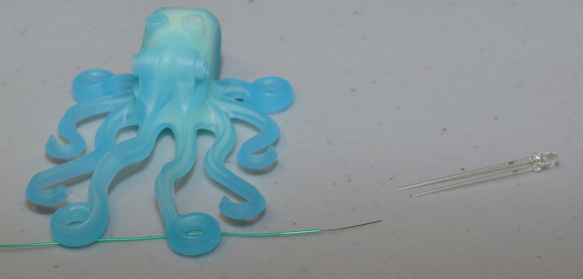
Building the Lights - Step 1
Pick a color of your 30-gauge wrapping wire
  We'll refer to this is negative, "-", or GND
Strip about 1/2" off the end leaving the rest attached to the spool

Slide 23
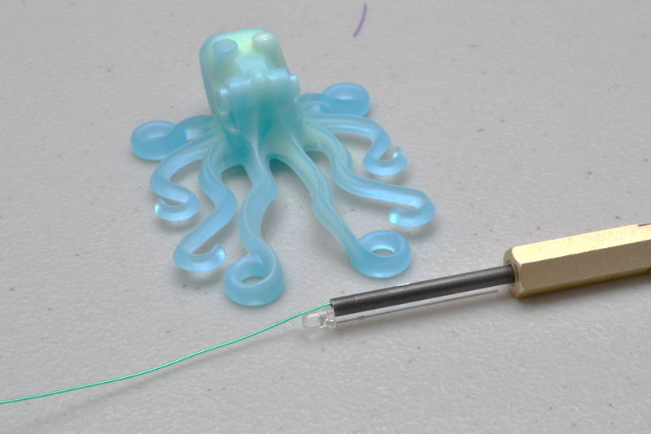
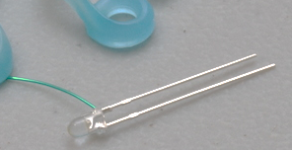
Building the Lights - Step 2
Insert the stripped end into the small hole in the wire-wrapping tool
Insert the short leg of the LED into the wire-wrapping tool's large hole
Hold the wire and LED in place, and twist the wire-wrapping tool clockwise
After 5-6 twists, you'll have a good connection!

Slide 24
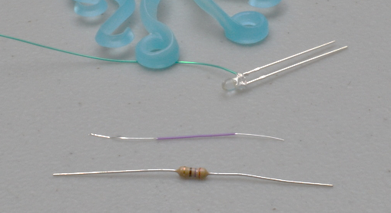
Building the Lights - Step 3
Pick a different color of your 30-gauge wrapping wire
We'll call this positive or "+"
Cut about 1 & 1/2 inches of wire from the spool
Strip about 1/2" from both ends.

Slide 25
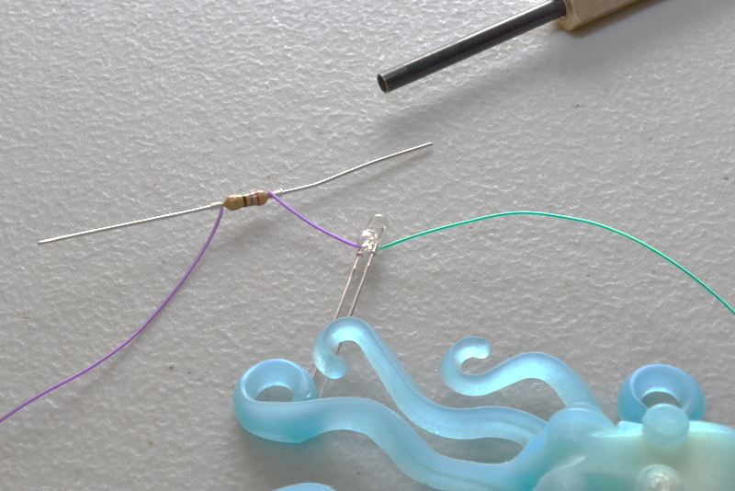
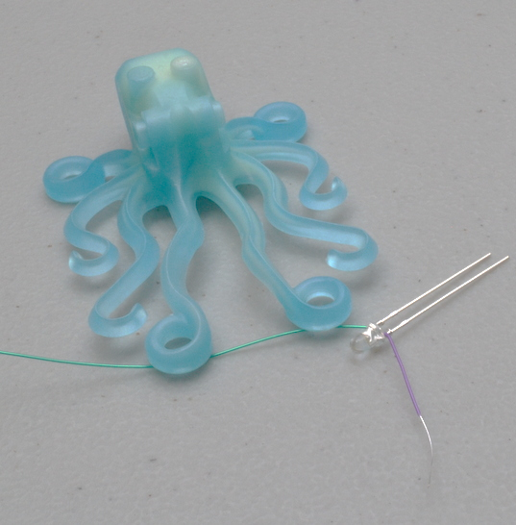
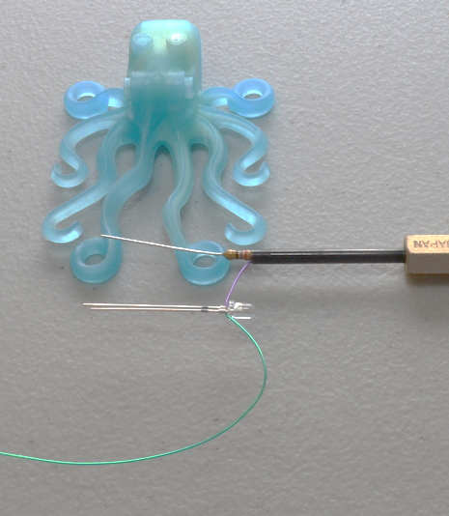
Building the Lights - Step 3 (Continued)
Wire wrap one end to the long lead on the LED (See Step 2)
Wire wrap the other end to either lead of a 27 Ohm resistor
Strip another 1/2" off the end of a new piece of the same color wrapping wire, leaving the rest on the spool
Wire wrap this to the unused lead of the 27 Ohm resistor

Slide 26
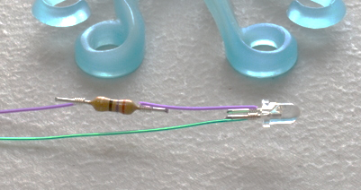
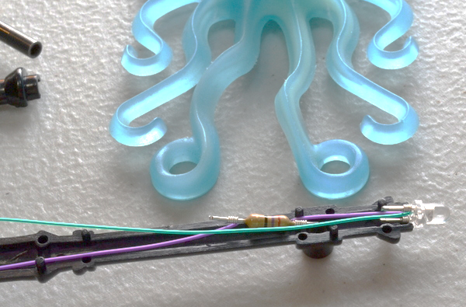
Building the Lights - Step 4
Cut the excess off of each of the LED's and resistor's leads
Optionally, tie a knot in the wire close to the LED & resistor - this will help relieve strain on those connections.
Stretch out the wire (still attached to the spool) so both colors are of an equal length, then cut to desired length.

Slide 27
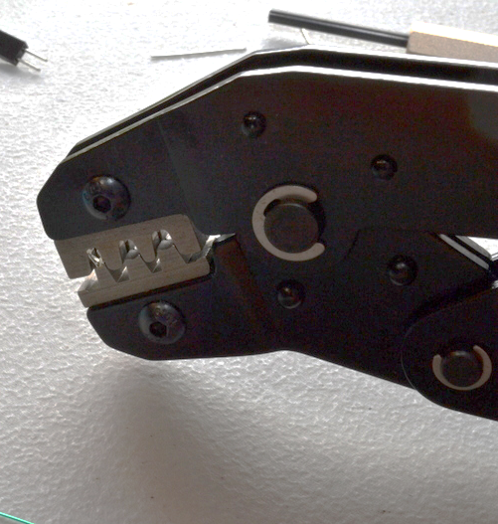
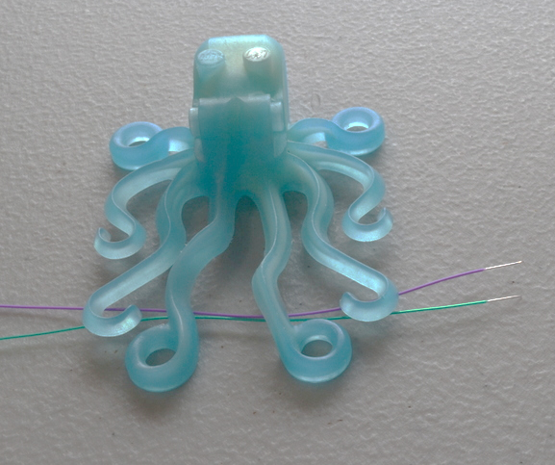
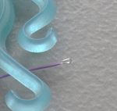
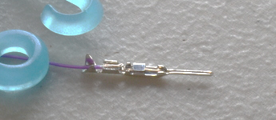
Building the Lights - Step 5
Strip about 1/4" off of each of the colors
Fold that 1/4" of bare metal back on to itself.
Crimp each of these wires into a male crimp pin.

Slide 28
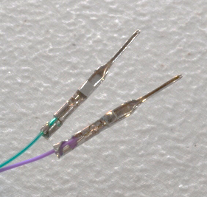
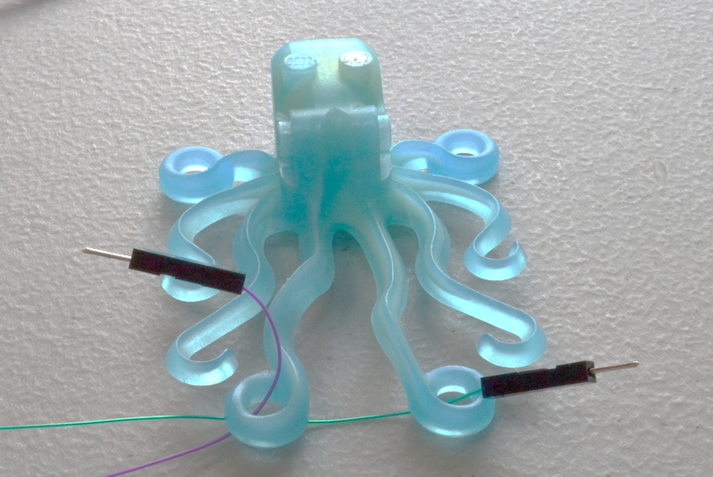
Building the Lights - Step 6
Be careful to line up the pin in the crimp tool correctly, and the wire in the crimp pin correctly. This will likely take some practice (I'm still not terribly good at it)
Insert each male crimp pin into a 1x1 pin crimp housing. You can tell if you've made a good crimp because the pin will go easily into the housing, and snap into place.

Slide 29
Options for Power Supply - AA or AAA batteries
The easiest by far is a simple battery box.
  You can get them from all over the place, I like the ones with a built-in switch.
If you plan on using rechargeable batteries:
  a two-cell box will give you 2.4v, and a fairly dim light
  a three-cell box will give you 3.6v, for a nice, bright light
If you are using alkaline batteries, a two-cell box will give you 3v
AA's will last longer than AAA's, but are bulkier.
If you're using this approach, simply crimp the two battery terminals into male pins, then insert them into a 1x2 pin crimp housing.

Slide 30
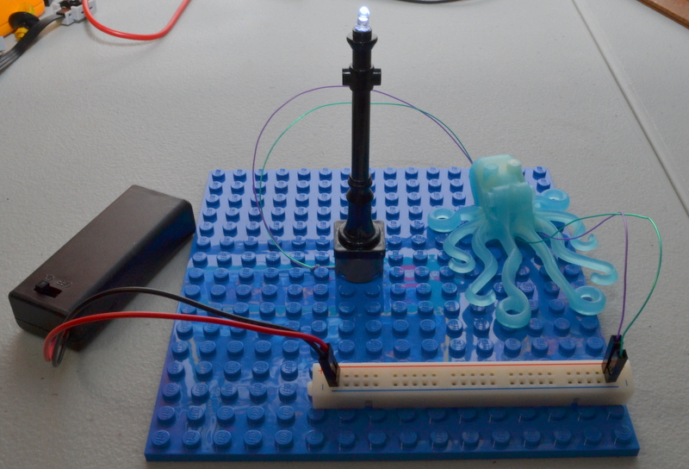
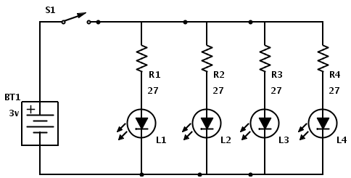
Options for Power Supply - AA or AAA batteries

Slide 31
Options for Power Supply - Power Functions
If you're up for some soldering, this is a much more powerful (pun intended) option.
Solder the header on to your 3.3v regulator (Pololu #2097)
  This regulator is only good for 300mA – that can power 30 lights comfortably.
  Options exist for higher output.
Cut & crimp the PF Extension cable (LEGO # 8886).
The pins (in this picture) from left to right are GND, C1, C2, 9V
  Connect GND from the PF Cable to GND on the regulator, and to the "-" bus on the breadboard
  Connect C1 from the PF Cable to VIN on the regulator
  Connect VOUT on the regulator to the "+" bus on the breadboard.

Slide 32
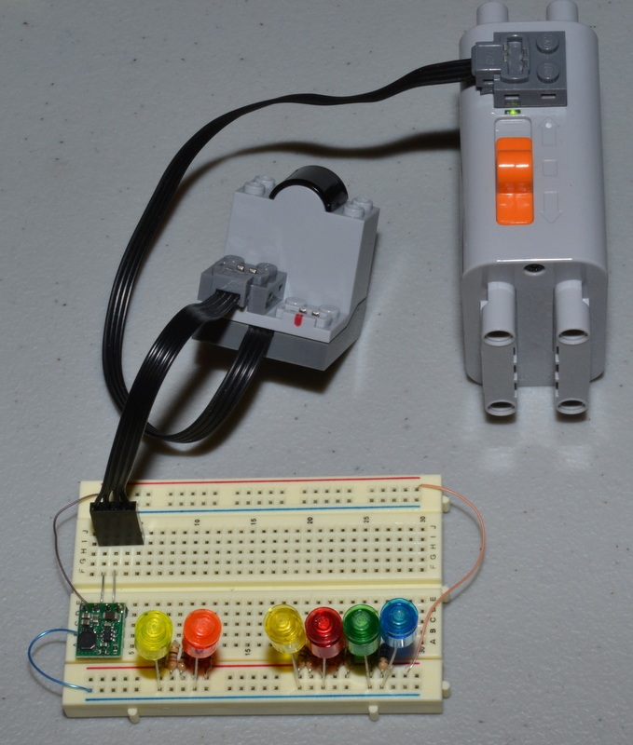
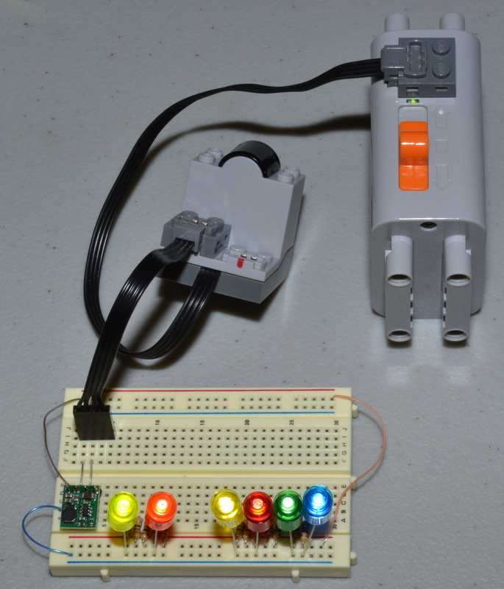
Options for Power Supply - Power Functions

Slide 33
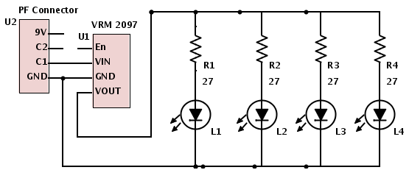
Options for Power Supply - Power Functions
What about the 9v pin from the PF cable?
  We're using C1 because it can allow for dimming with the rechargeable battery box, or IR receiver!
We can dim our lights just like LEGO dims the official LED's - with PWM.

Slide 34
How long will these lights run?
I don’t actually know, but I can make a good guess.
It depends a lot on the supply voltage, and the capacity of the power source (usually measured in mAh, or milliamp-hours)
A single LED on two alkaline AAA batteries could last about 65 hours!
  These lights are using somewhere in the neighborhood of 11mA @ 3.3v
  AAA Alkaline batteries are usually about 1000 mAh @ 3.0v
  The Voltage regulator is about 80% efficient.

Slide 35
Room for Improvement in Version 4!
Connectors are still a bit large.
  Shorter connectors would be ideal.
Having two individual connections on the LED leads is not great.
  How to fit a two-conductor
More testing is needed to make it work with 9v system as well.
  Maybe sing 9v train track as power distribution?

Slide 36
Resources
How-to video on crimping: https://www.youtube.com/watch?v=GkbOJSvhCgU
How-to video on wire-wrapping: http://www.youtube.com/watch?v=qLt6a6_Rm20

Slide 37


Questions?
Questions? Ideas? Get in touch!
smart_as_a_brick on flickr
jwsmart on brickset
Leave a comment on ilugny.org
  This presentation will be posted on ilugny.org later today.
Come and talk to me, I’ll probably be working on the Monorail!

