Slide 1
Lights! Camera! Action! LEGO Animation Workshop
Notes:
Welcome to Lights! Camera! Action! LEGO Animation Workshop. Today we’re going to learn how to make stop-motion animated LEGO videos.

Slide 2
What is Animation?
Creating motion.
Movie= A series of images played quickly. (aka a Motion Picture)
Notes:
Animation is the act of creating motion. If you throw a baseball, you’re animating it.
Movies are just thousands of individual photographs (called “frames”) played at a high speed, tricking our brains into thinking it’s moving. Hence why they’re called “motion pictures.”

Slide 3
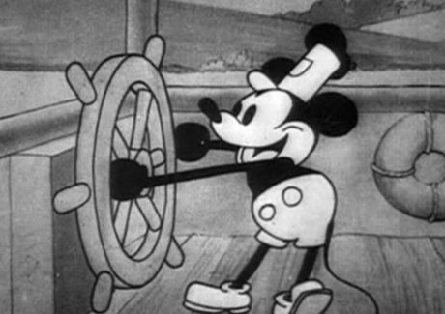
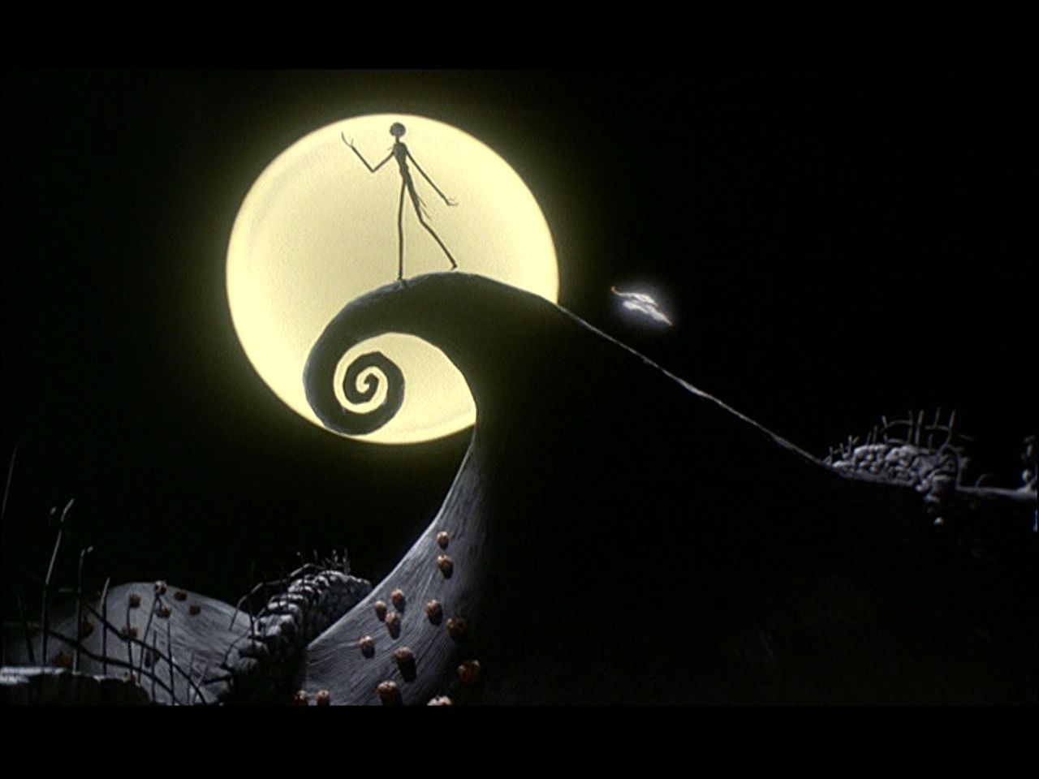
Kinds of Animation
Hand-drawn
Computer
Stop-motion
Notes:
There are three kinds of animation.
1. 2D, hand-drawn animation. These movies are made of thousands of drawings done on paper. (Adventure Time)
2. Computer-generated animation, where 3D models are created in the computer. (Toy Story)
3. Stop-motion (or stop-frame) where real objects are photographed and appear to move on their own. (Nightmare Before Christmas)

Slide 4
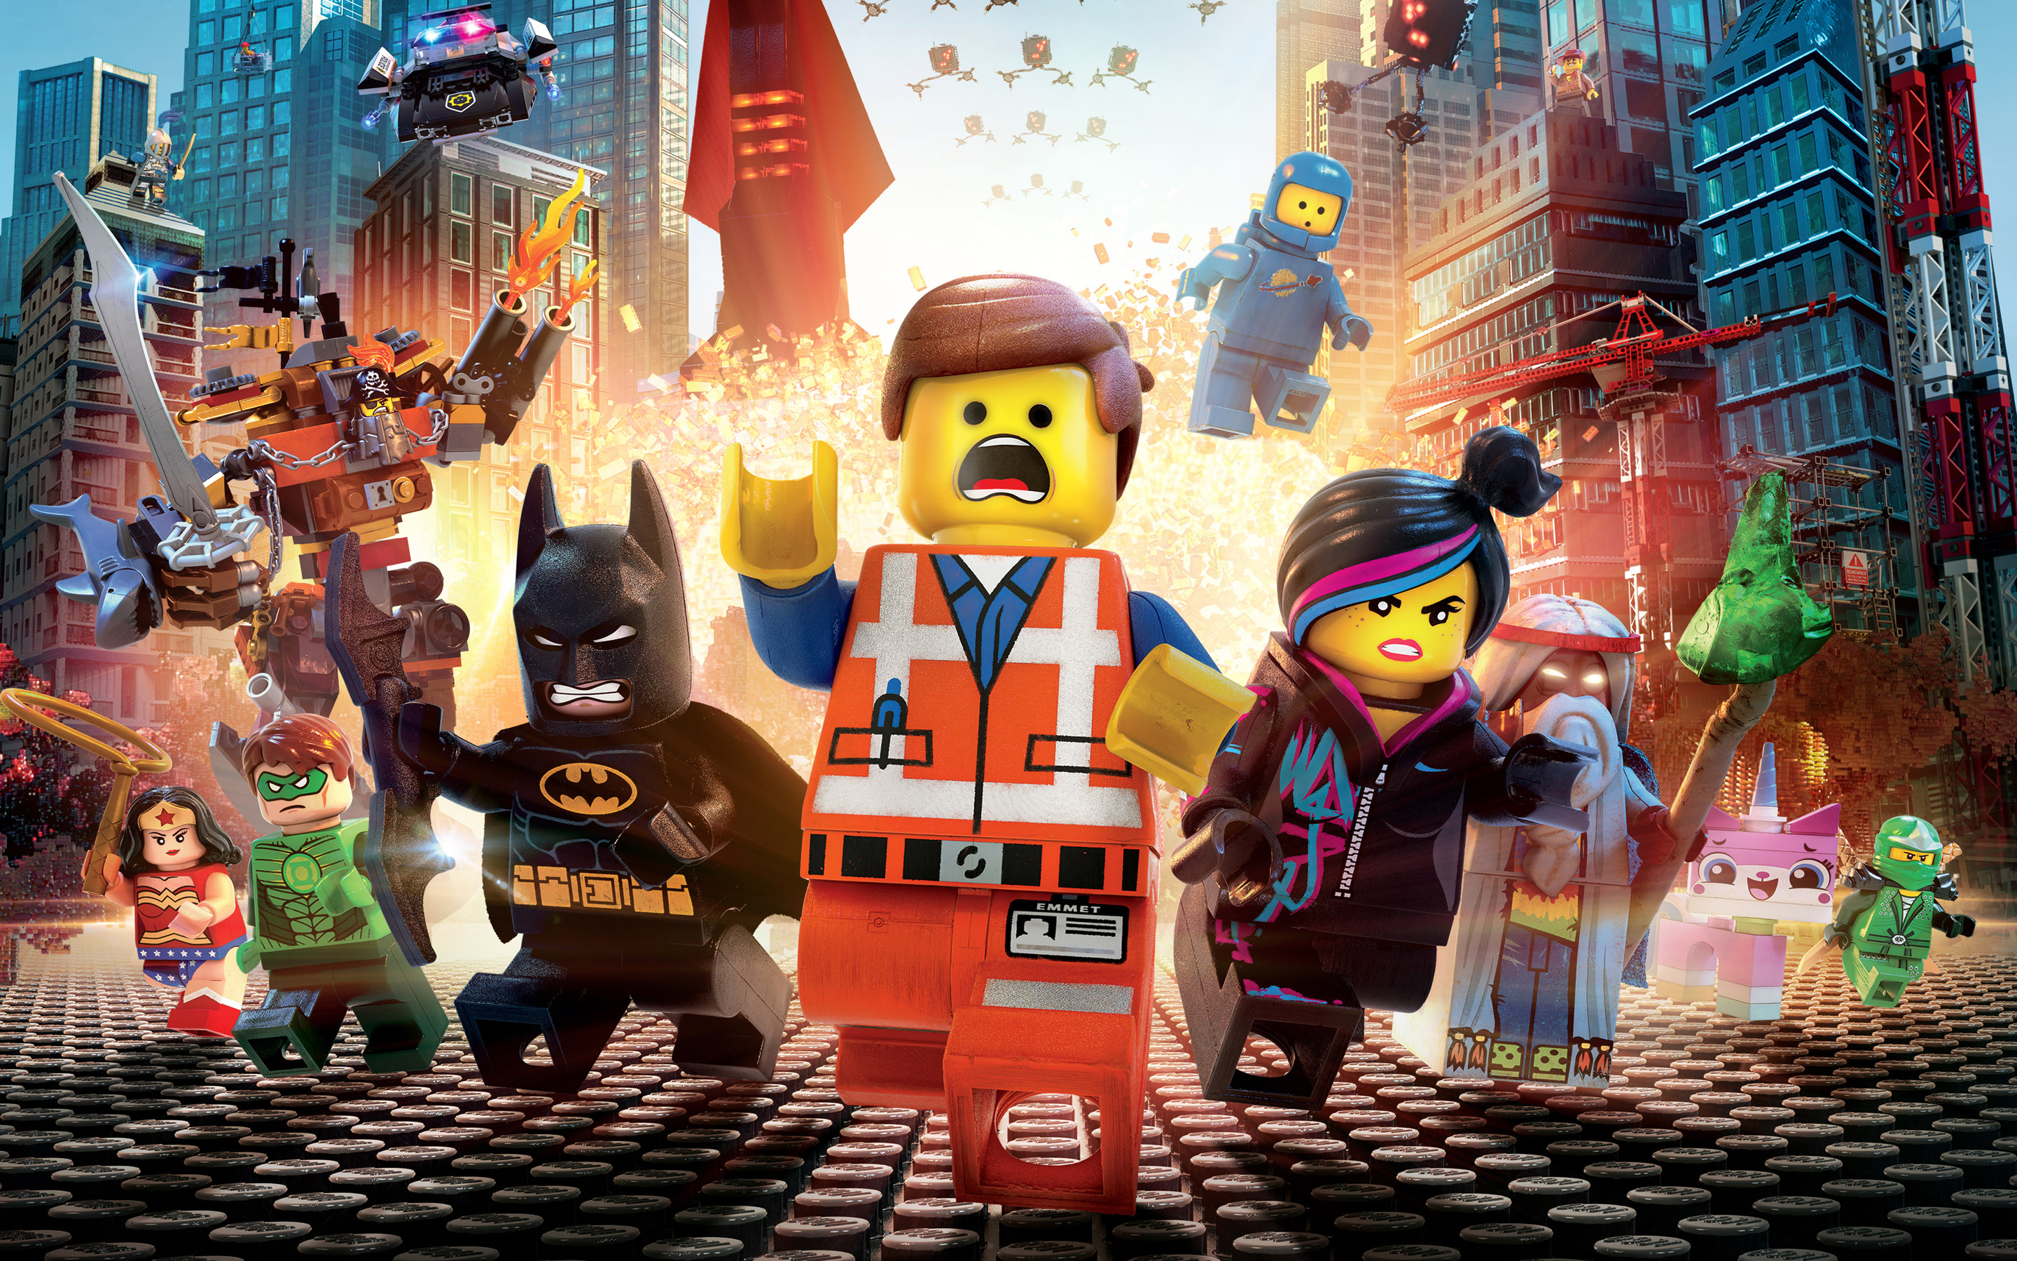
Brickfilms
A movie made using LEGO.
Notes:
Any movie made using LEGO is called a brickfilm. The LEGO Movie is done in the style of stop-motion, but it is mostly computer-generated with some stop-motion mixed in.

Slide 5
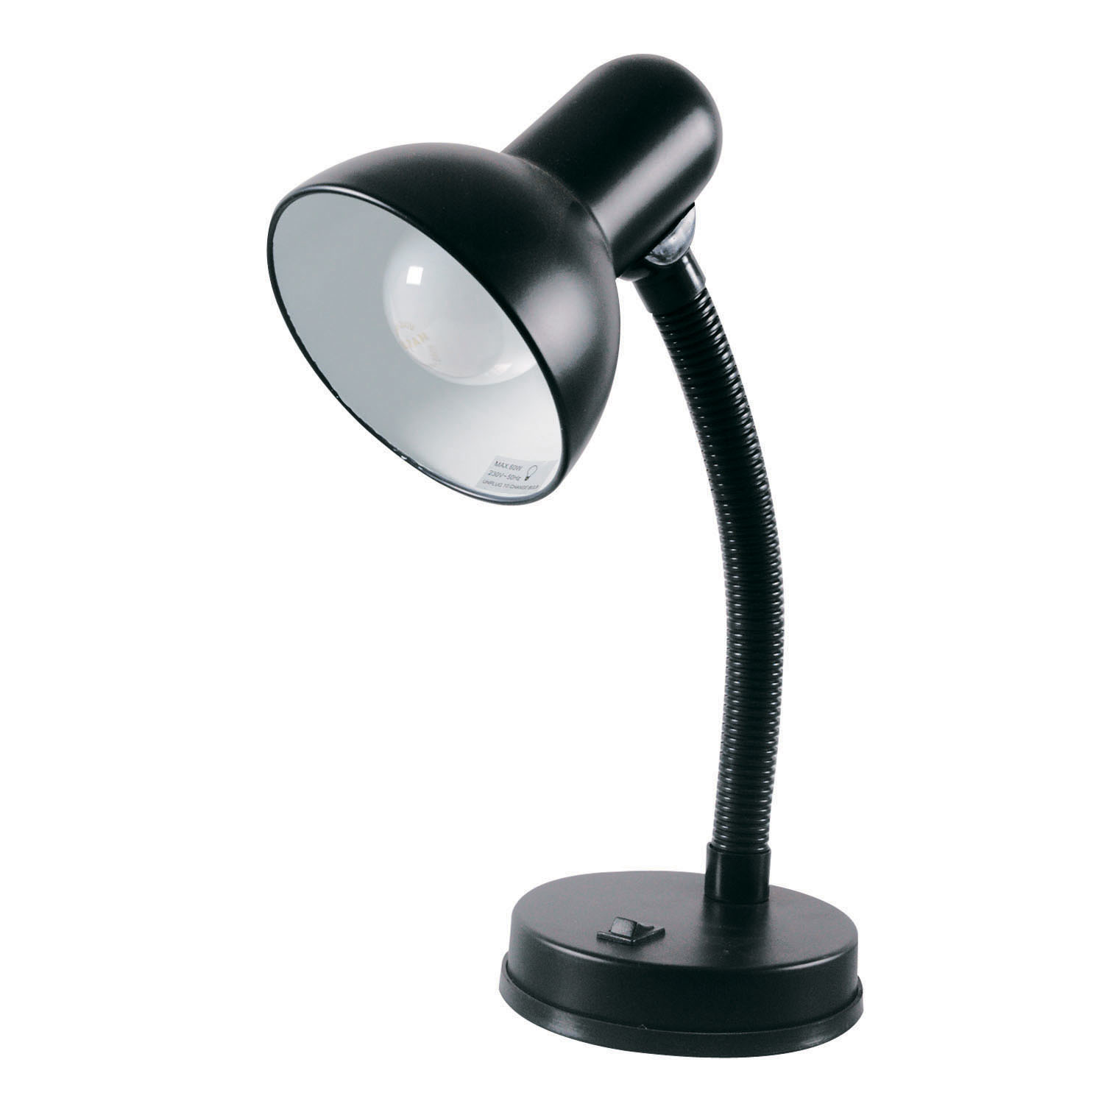
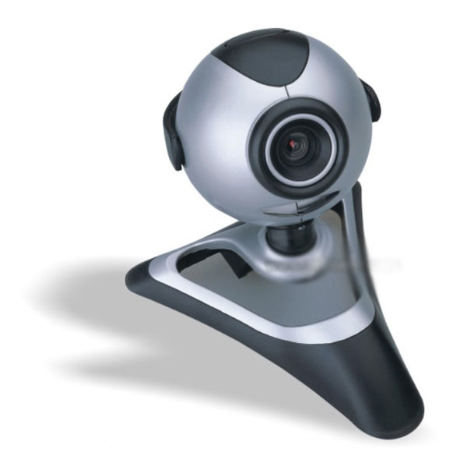
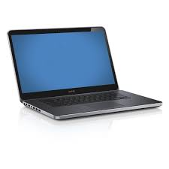
Materials
LEGO
Lights
Camera
Poster Putty
Computer
Notes:
To do a stop-motion brickfilm, you only need a few things. You’ll probably have most if not all of these in your house already.
LEGO
LIGHTS – any table lamp could work. Something adjustable is best.
A CAMERA – anything from a webcam to a point-and-shoot to a DSLR can work.
POSTER PUTTY – sticks things down without leaving residue. Use it for the camera and set to keep them from moving.
A COMPUTER – Mac, PC, desktop, laptop, doesn’t matter.

Slide 6
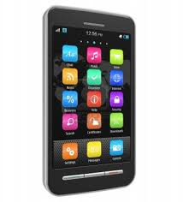
Stop-Motion Software
Smartphone Apps
Computer Software
the LEGO Movie Maker (iOS)
GorillaCam (iOS)
Lapse It (Android)
Stop Motion Café (iOS)
Frameographer (iOS)
Monkey Jam (PC)
Stop Motion Animator (PC)
Dragonframe (PC, Mac)
iStopMotion (Mac, iPad)
Stop Motion Pro (PC)
Blue = Free!
Notes:
There are a bunch of stop-motion programs out there. The blue ones are free.
If you have a smartphone, there are stop-motion apps like:
the LEGO Movie Maker (iOS)
GorillaCam (iOS)
Lapse It (Android)
Stop Motion Café (iOS)
Frameographer (iOS)
There are also a ton of computer programs for stop-motion, including some free ones like:
Monkey Jam (PC)
Stop Motion Animator (PC)
Dragonframe (PC, Mac)
iStopMotion (Mac, iPad)
Stop Motion Pro (PC)
With these programs, you can easily review your work and do more precise animating than you would just using a camera. There’s a feature called onion-skinning.

Slide 7
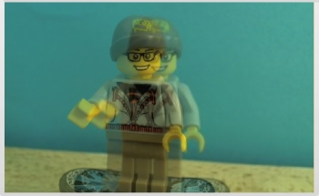
Onion-skinning
Notes:
…which looks like this. So you get a double image of where the skater is now compared to where he was in the previous frame. It lets you see how much movement is happening between frames so you can fine-tune the animation.

Slide 8
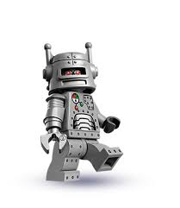
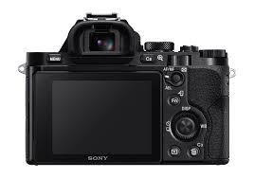
Studio Setup
Notes:
When you have everything ready, you arrange your studio on a sturdy table like they are in this picture.
If you have a camera plugged into a computer, you can take pictures using the computer so you don’t have to touch the camera and risk moving it.

Slide 9
Animating
Notes:
When you animate, you first pose your subject and take a picture of it. Now you move your subject very very slightly and take a picture of it again. Repeat this process until you have a full action.
You can animate a person walking, a car driving down the road, or anything you want! When you play back all your images quickly, it’ll turn into a video.
You need to choose a frame rate, or how many frames per second you want to do. Feature-length animated films are done at 24 frames per second, but you can start small (4-8fps) and work your way up to 12-18fps. That’s an acceptable level of smooth movement.

Slide 10
The Walk Cycle
Notes:
So something simple like a walking cycle involves multiple frames as you can see here. You have the figure standing, take a picture, lift one foot, take a picture, lift a little higher, take a picture, and so on. This is tricky and takes practice to master.
You can play with different speeds by making the movements take more or less frames. Like, for example, you can skip every other frame and the minifigure will run instead of walk.

Slide 11
Tips
1. Lock down the camera!
2. Stay organized!
3. Block outside light!
4. Be patient!
Notes:
Lock down the camera! The camera should only move when you want it to.
Stay organized. Keep your workspace clean so you have room to work.
Avoid unwanted light spilling into your set. Other lights can make light flicker in your movie.
Animation is time-consuming and a lot of hard works. Be patient and take breaks.

Slide 12
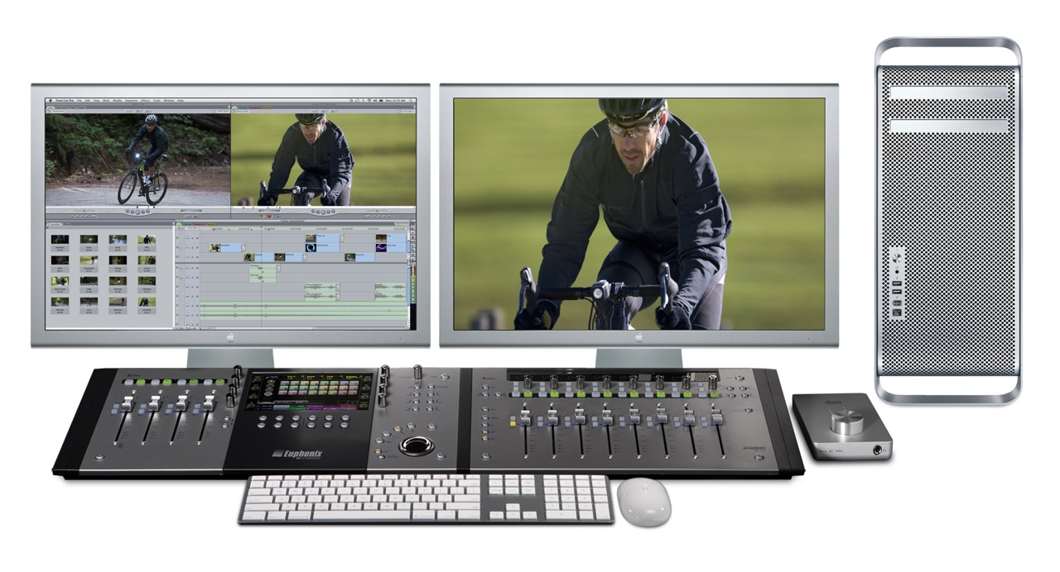
Editing
Upload your pictures into video editing software.
Add special effects and audio.
Notes:
When you’re done, you can either export your project as a movie file or import a folder of your pictures into an editing software. Again, there are a lot of options. Windows Movie Maker, iMovie, Final Cut, AVID, Premiere, and so on. In your edit program you can add special effects, sounds, and titles to finish your movie.

Slide 13
This slideshow will be available at: WWW.LUGNY.ORG/presentations/

